Slide 1
HTML Workshop!
Johan Ng and Muhammad Hazzry

Slide 2
https://tinyurl.com/yagwfevl
Notes:
Used to create web documents
Markup language = set of markup tag
Tags describe document content

Slide 3
Hyper Text Markup Language
Notes:
Used to create web documents
Markup language = set of markup tag
Tags describe document content

Slide 4
HTML Structure
<html>
<body>
<p>
</p>
</body>
</html>
Notes:
html>
The opening <html> tag indicates that anything between it and a closing </html> tag is HTML code
The <body> tag indicates that anything between it and a closing </body> tag is shown inside the main browser window
Other contents that is to be in the main browser should be defined within their own tags.
e.g.
• <p> … </p>
• <div> … </div>

Slide 5
HTML Tags
<h1> content </h1>
Opening Tag
Closing Tag

Slide 6
Key important Tags
Title <title> </title>
Headers <h1> </h1>
Paragraph <p> </p>
Horizontal Line <hr>
Line Break <br>
Images <img src “”>
Links <a href = “”> </a>
Ordered list <ol> </ol>
Unordered list <ul> </ul>
List element <li> </li>

Slide 7
Title
<title> this is a title <title>

Slide 8
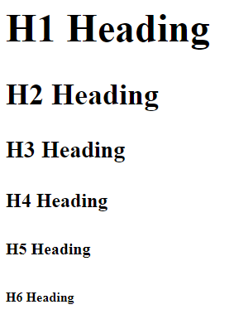
Headers
<h1>H1 Heading</h1>
<h2>H2 Heading</h2>
<h3>H3 Heading</h3>
<h4>H4 Heading</h4>
<h5>H5 Heading</h5>
<h6>H6 Heading</h6>

Slide 9
Paragraphs and line break

Slide 10
Paragraphs and line break
<p>wall of text</p>
<p>wall of text<br>
wall of text<br>
wall of text<br>
wall of text<br></p>

Slide 11
Horizontal lines
<p>this is a horizontal line!<hr></p>

Slide 12
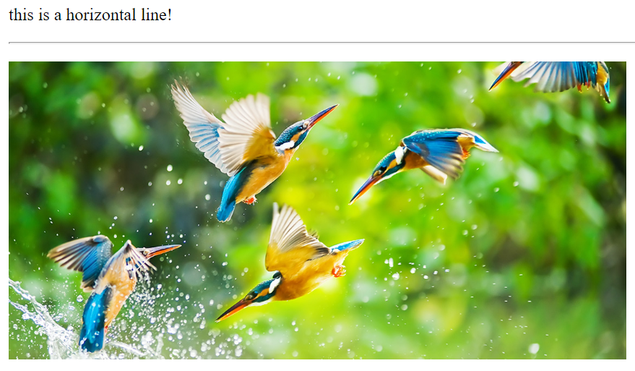
Images
<p><img src = "https://www.gettyimages.ie/gi-resources/images/Homepage/Hero/UK/CMS_Creative_164657191_Kingfisher.jpg" alt="Image" height="275" width="570" > </p>

Slide 13
Hyperlink
<p><a href= "https://www.google.com/">google</a></p>

Slide 14
Formatting elements
Bold <b> </b>
italics <i> </i>
Underline <u> </u>
Strikethrough <s> </s>
Strong <strong> </strong>
Notes:
https://www.w3schools.com/html/html_formatting.asp

Slide 15
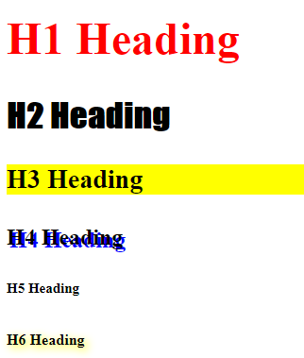
Styles!
<h1 style = "color: red"> H1 Heading </h1>
<h2 style = "font-family: Impact"> H2 Heading </h2>
<h3 style = "background-color: yellow"> H3 Heading </h3>
<h4 style = "text-shadow: 2px 2px blue"> H4 Heading </h4>
<h5 style = "font-size: 10px"> H5 Heading </h5>
<h6 style = "text-shadow: 2px 2px 10px yellow"> H6 Heading </h6>
Notes:
https://www.w3schools.com/html/html_styles.asp

Slide 16
Cascading style sheets
H1 {color:blue;}
Selector
Property
Value

Slide 17
Try it yourself!

Slide 18
Getting started
Create a folder by name “Workspace” on your desktop
Open Wordpad, save it as “index.html”
Follow me!

